Slide 1

Unit 4: ACTIVITIES
Lesson 4
Page 57

Slide 2
Objectives
By the end of this lesson, students will be able to learn vocabulary and structure to talk about where they do some different activities that are popular in their culture.
Vocabulary: studio, soccer field, arcade, skate park, bookstore.
Structure:
What is she doing?
She’s dancing at the studio.
What are they doing?
They are playing soccer at the soccer field.

Slide 3

WARM UP

Slide 4

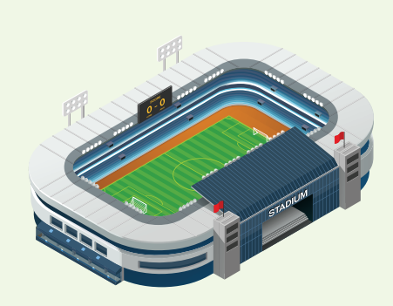
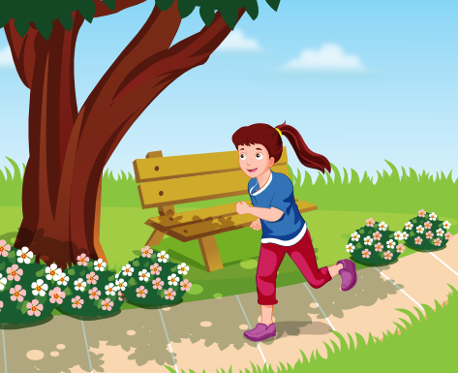
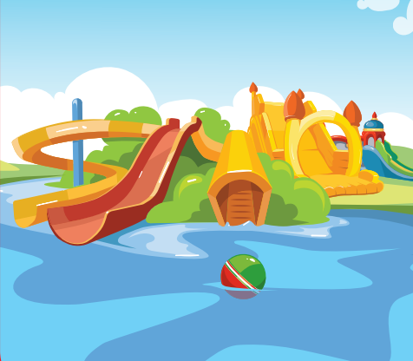
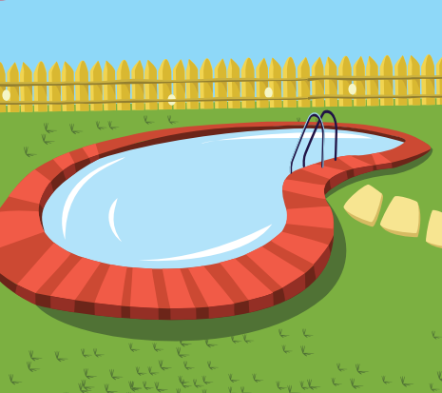
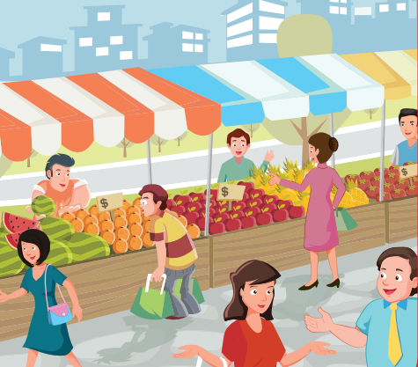
REVIEW 1
library
stadium
park
water park
swimming pool
market

Slide 5
REVIEW 2
What’s next?
?
?

Slide 6
REVIEW 2
What’s next?
?
?

Slide 7
REVIEW 2
What’s next?
?
?

Slide 8

It’s time to learn …

Slide 9

New words
studio, soccer field, arcade, skate park, bookstore.

Slide 10

Presentation

Slide 11

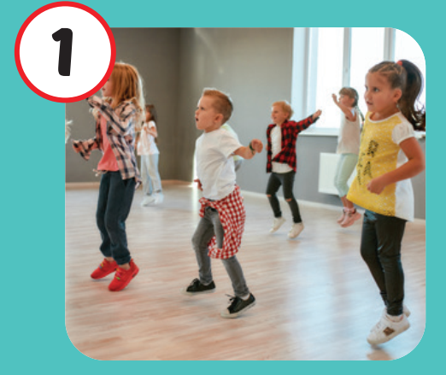
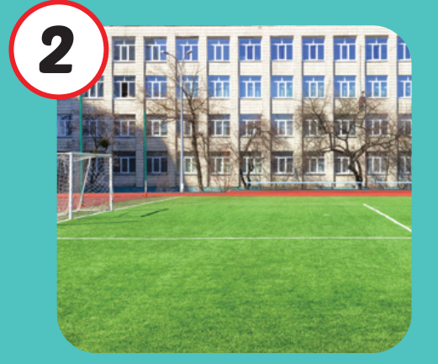
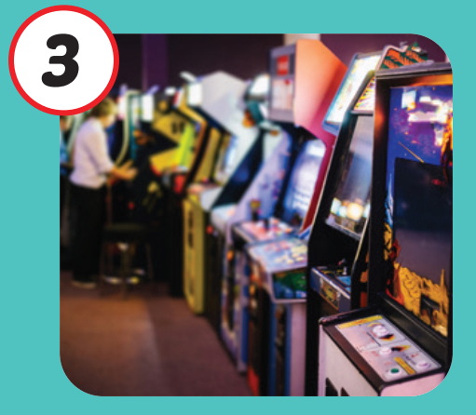

Click on each English word to hear the sound.
studio
soccer field
arcade
/ˈstuːdioʊ/
phòng tập
/ˈsɑːkər fiːld/
sân đá bóng
/ɑːrˈkeɪd/
khu vực máy giải trí

Slide 12

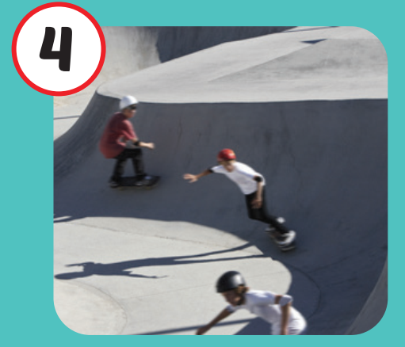
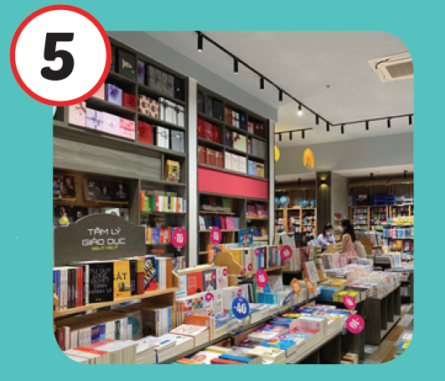
Click on each English word to hear the sound.
skate park
bookstore
/skeɪt pɑːrk/
khu trượt ván
/ˈbʊkstɔːr/
nhà sách

Slide 13

Practice

Slide 14
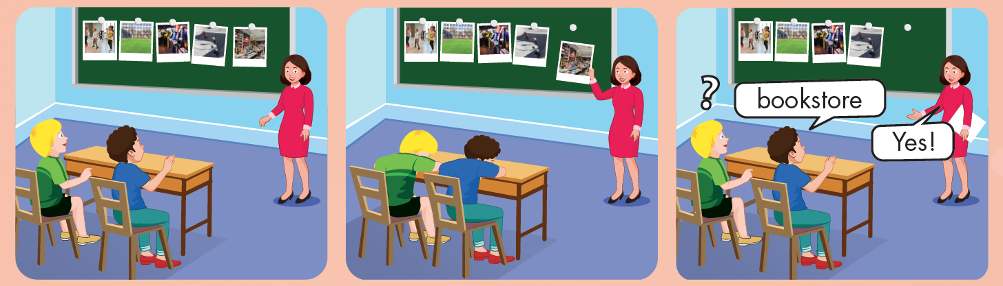

Slide 15

WHAT IS IN THE CLOCK?
HOW TO PLAY
Press START to play.
Click CHECK to show the answer.

Slide 16


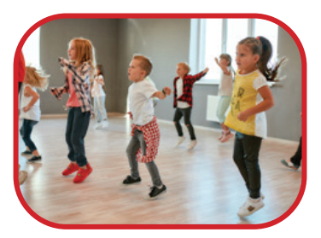
START
CHECK

Slide 17
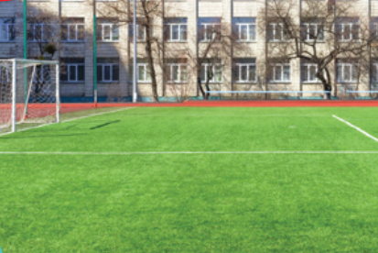
START
CHECK

Slide 18
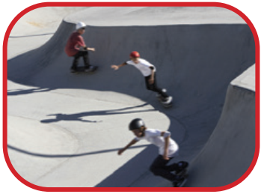
START
CHECK

Slide 19
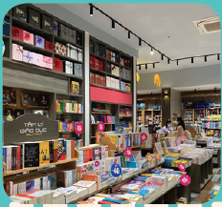
START
CHECK

Slide 20
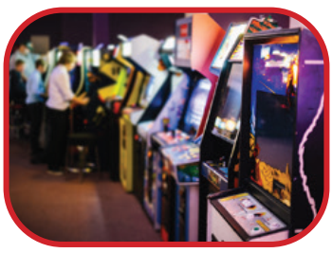
START
CHECK

Slide 21
WHAT’S MISSING?
soccer field
studio
bookstore
bookstore
arcade
skate park
skate park
skate park
studio
arcade
soccer field
studio
arcade
bookstore
bookstore
soccer field
skate park
skate park
studio
soccer field
soccer field
arcade
arcade
studio
studio
soccer field
bookstore
bookstore

Slide 22
Structures
What is she doing?
She’s dancing at the studio.
What are they doing?
They’re playing soccer at the soccer field.

Slide 23

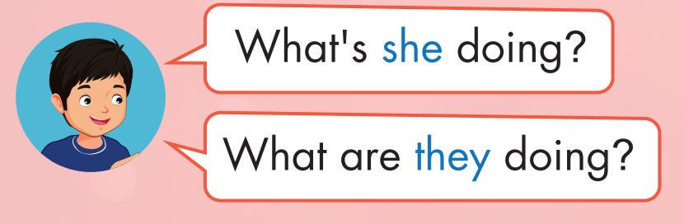
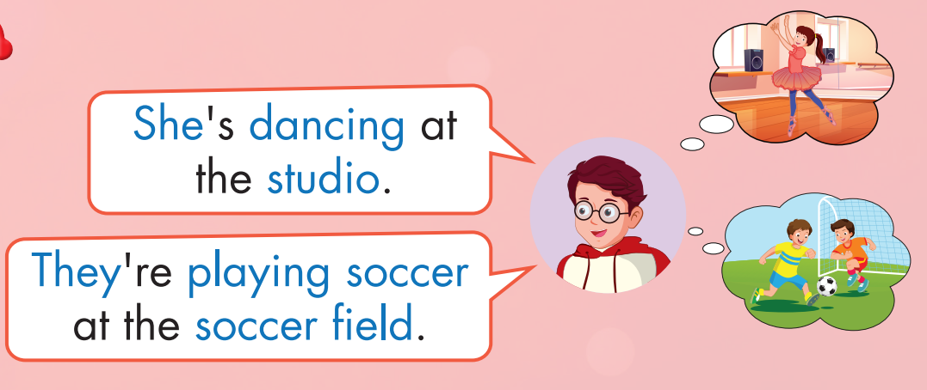
Click on the headphone icon to hear the sound.

Slide 24
Practice

Slide 25
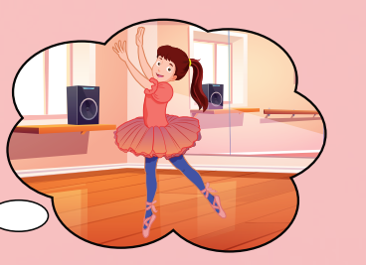


What is she doing?
She’s dancing at the studio.

Slide 26
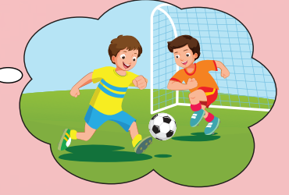
What are they doing?
They’re playing soccer at the soccer field.

Slide 27
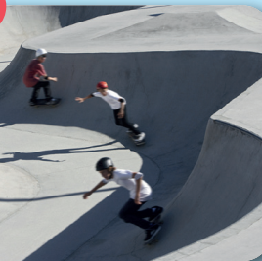
What are they doing?
They’re skating at the skate park.

Slide 28

What is he doing?
He’s playing at the arcade.

Slide 29
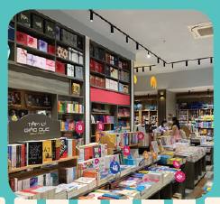
What are they doing?
They’re reading at the bookstore.

Slide 30

CONSOLIDATION

Slide 31

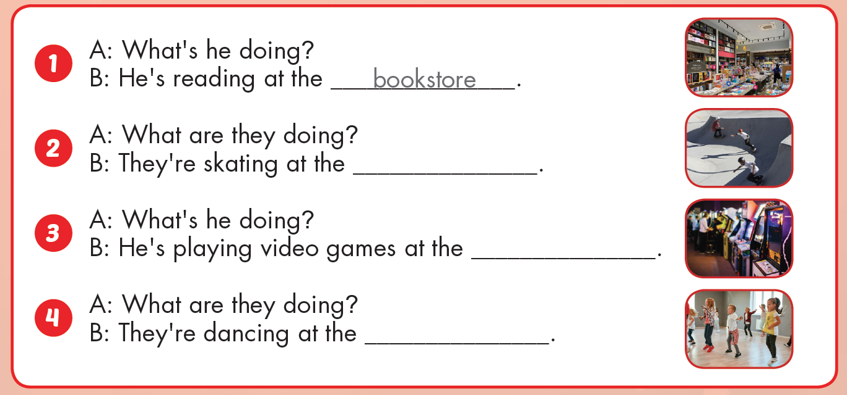
skate park
arcade
studio

Slide 32

WRAP-UP

Slide 33
Today’s lesson
Vocabularies
studio, soccer field, arcade, skate park, bookstore.
Structures/ Sentence patterns
What is she doing?
She’s dancing at the studio.
What are they doing?
They are playing soccer at the soccer field.

Slide 34
Homework
Practice the vocabulary and structure, and make sentences using them.
Do the exercises in Tiếng Anh 4 i-Learn Smart Start WB (page 38)
Do the exercises in Tiếng Anh 4 i-Learn Smart Start Notebook (page 25)
Prepare the next lesson (page 58 SB)
Play the consolidation games in Tiếng Anh 4 i-Learn Smart Start DHA App on www.eduhome.com.vn

